Slide 1
Building An AI Pipeline For Image Segmentation And Object Analysis Summarizing The Approach, Impl
Ram Kumar

Slide 2
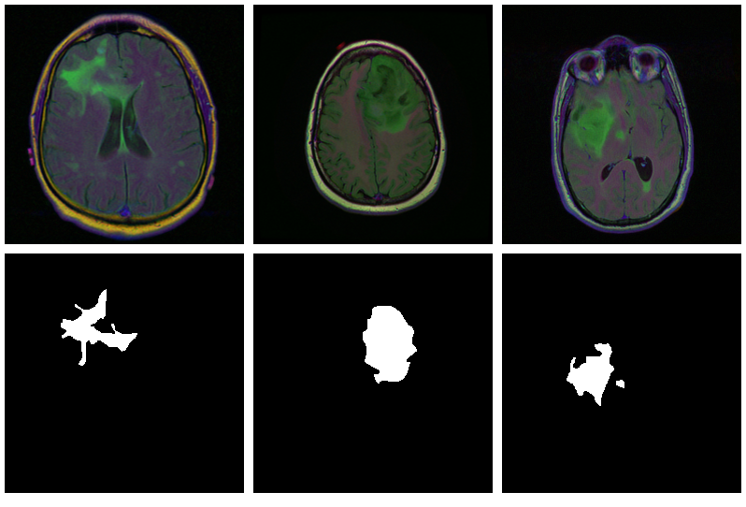
Introduction to AI Pipeline for Image Segmentation
Image segmentation involves partitioning an image into multiple segments to simplify analysis.
Object analysis focuses on identifying and classifying objects within segmented regions.
Combining these techniques enhances machine understanding of visual data, important for various applications.
Notes:
Image source: https://www.researchgate.net/figure/Step-by-step-illustration-of-the-segmentation-pipeline-developed-for-the-segmentation-of_fig1_365291530

Slide 3
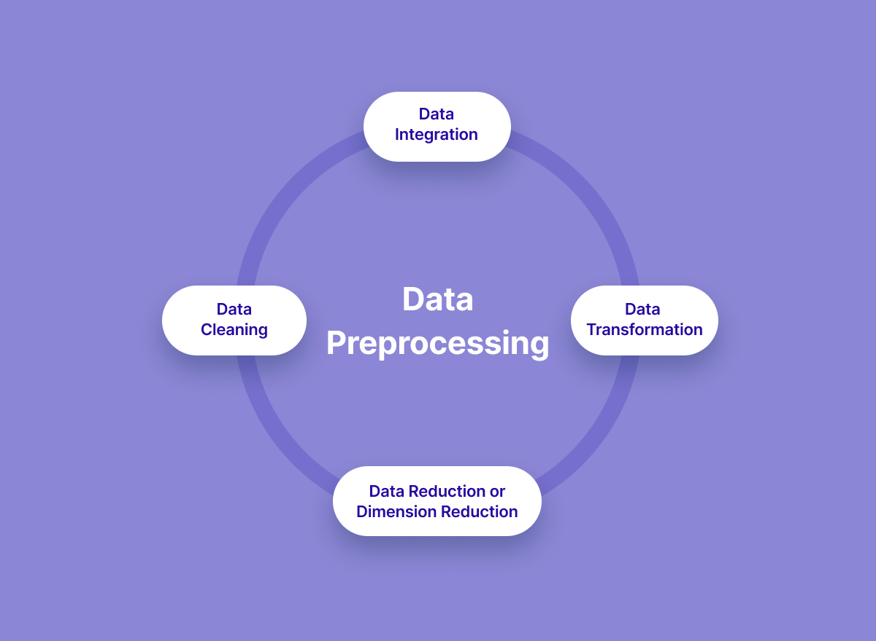
Data Collection and Preprocessing
The first step is gathering a diverse dataset of images relevant to the desired application.
Preprocessing techniques, such as normalization and resizing, ensure consistency in input data.
Data augmentation techniques, like rotation and flipping, help improve the model's robustness and performance.
Notes:
Image source: https://www.v7labs.com/blog/data-preprocessing-guide

Slide 4
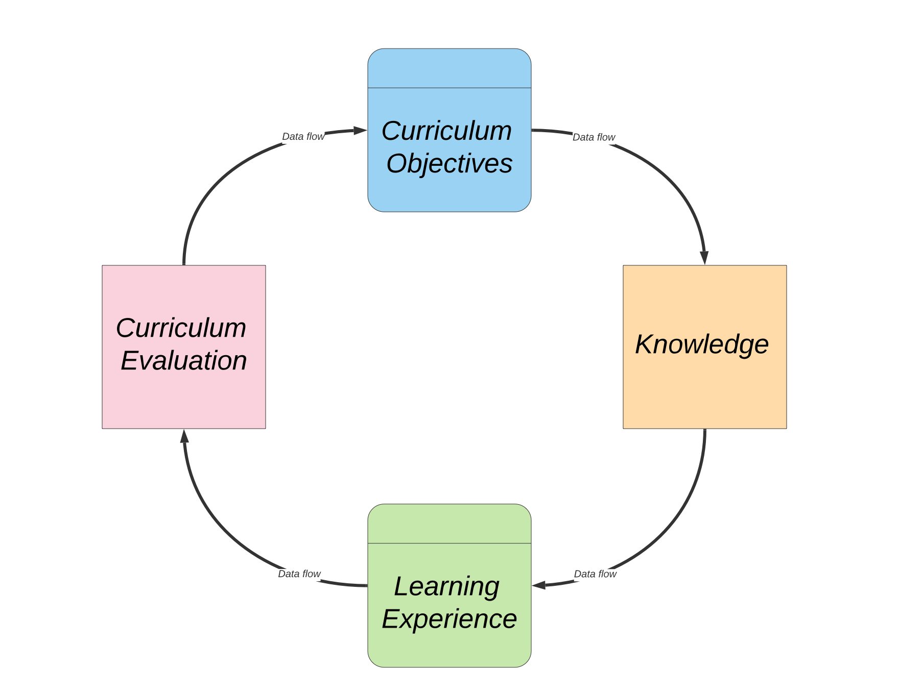
Model Selection and Training
Selecting a suitable architecture, such as U-Net or Mask R-CNN, is crucial for effective segmentation.
The training process involves feeding the model labeled images to learn the mapping from input to output.
Hyperparameter tuning and validation techniques help optimize performance and avoid overfitting.
Notes:
Image source: https://www.vrogue.co/post/figure-4-from-an-improved-mask-r-cnn-model-for-multiorgan-segmentation

Slide 5
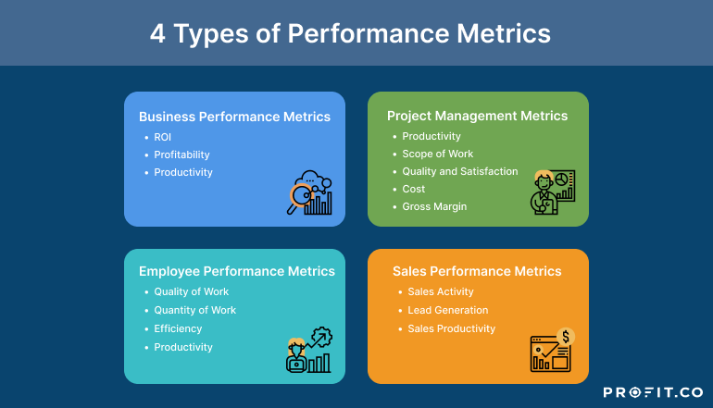
Evaluation Metrics for Performance
Common metrics for image segmentation include Intersection over Union (IoU) and Dice coefficient.
Object analysis can be evaluated through precision, recall, and F1 score to measure detection accuracy.
Continuous evaluation and benchmarking against datasets help in assessing model effectiveness.
Notes:
Image source: http://www.profit.co/blog/kpi-library/introductory-guide-to-understanding-performance-metrics/

Slide 6
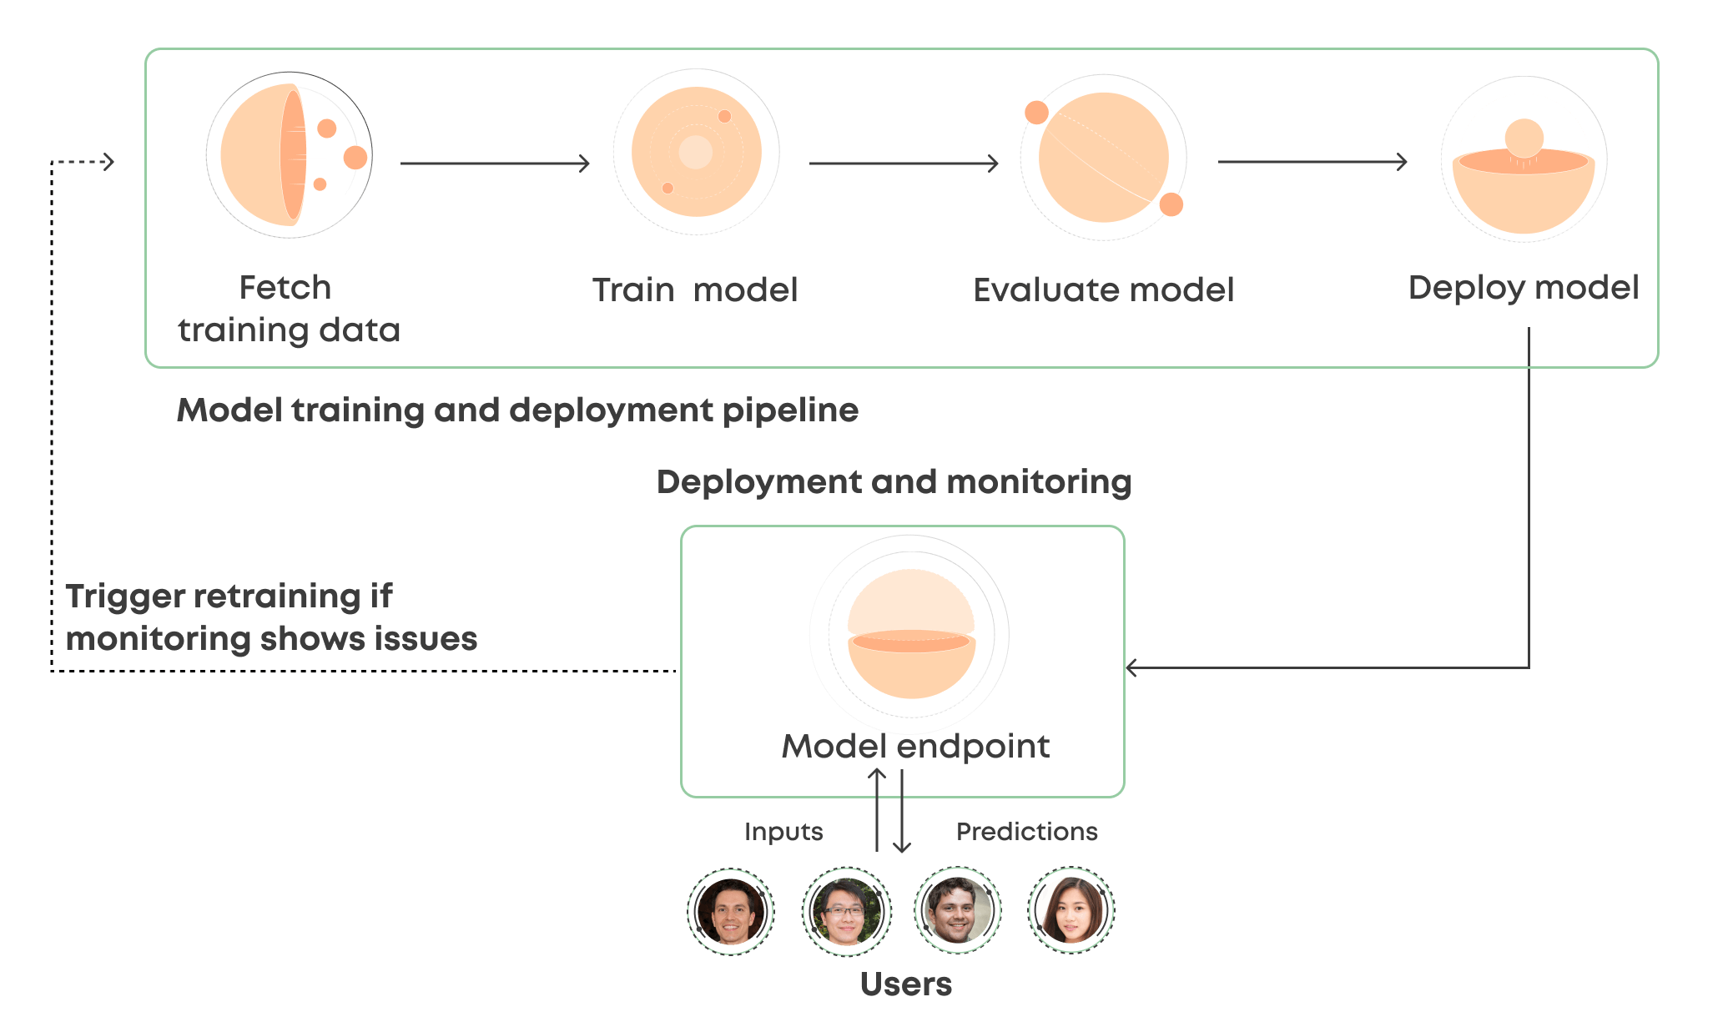
Deployment Strategies
Once trained, the model can be deployed using cloud services or on-premises solutions for scalability.
Real-time inference capabilities can be achieved through optimization techniques like model quantization.
Monitoring and updating the deployed model are essential to maintain performance over time.
Notes:
Image source: https://valohai.com/model-deployment/

Slide 7
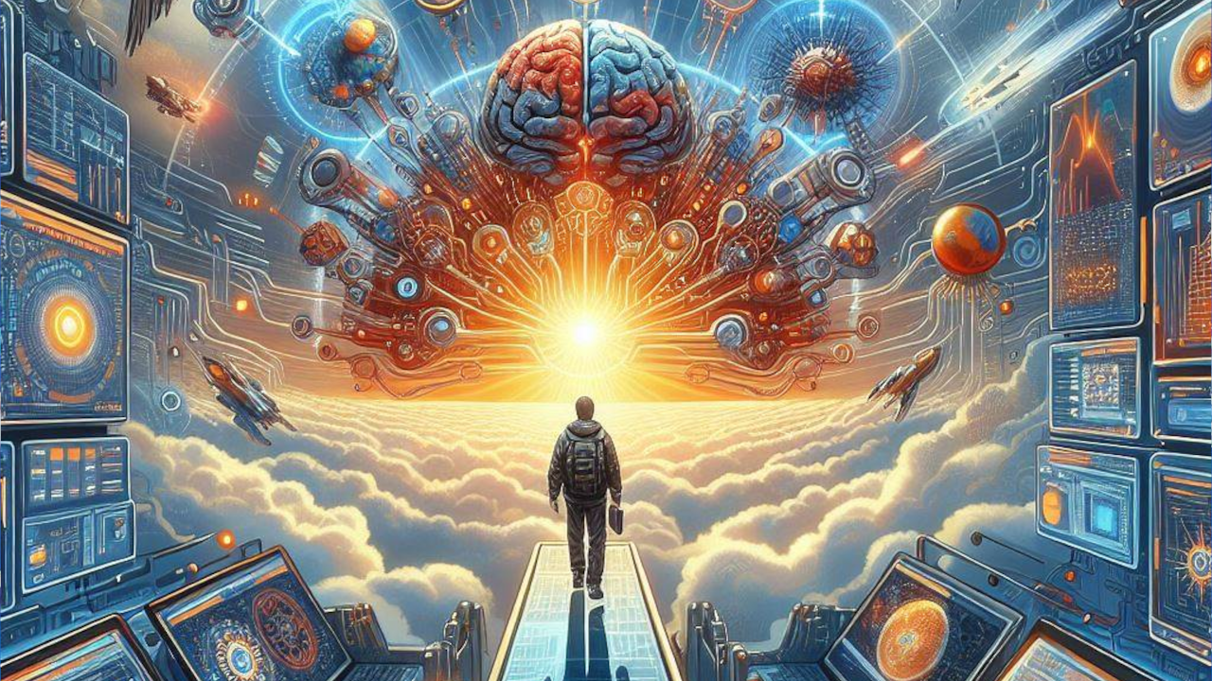
Future Directions and Challenges
The integration of explainable AI approaches can improve transparency in decision-making processes.
Addressing challenges like domain adaptation will enhance the model's performance across varying datasets.
Ongoing research into unsupervised and semi-supervised learning holds promise for reducing labeled data dependency.
Notes:
Image source: https://aimodels.org/neuromorphic-computing/challenges-future-directions-neuromorphic-computing/

